Slide 1
SUPERSTORE SALES ANALYSIS

Slide 2
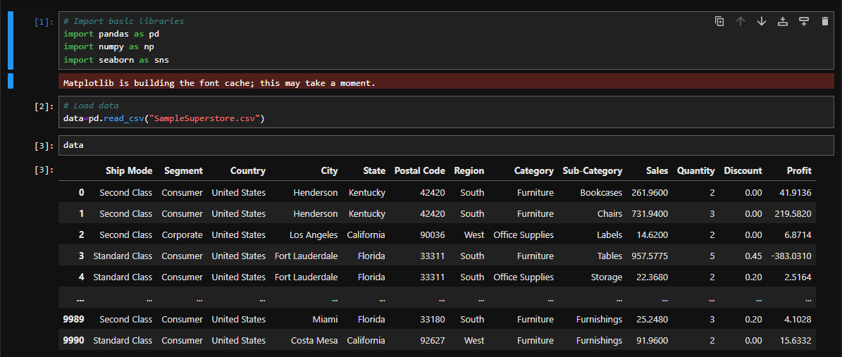
DATA EXPLORATION
Loading Data into Jupyter notebook and assigning it to an variable called ‘data’

Slide 3
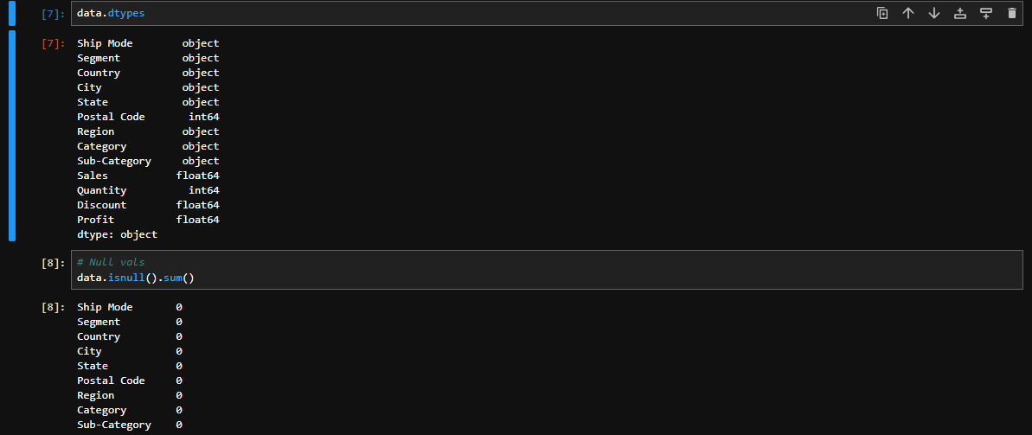
EXPLORE THE STRUCTURE OF THE DATA
Check for missing values and understand the datatypes available

Slide 4
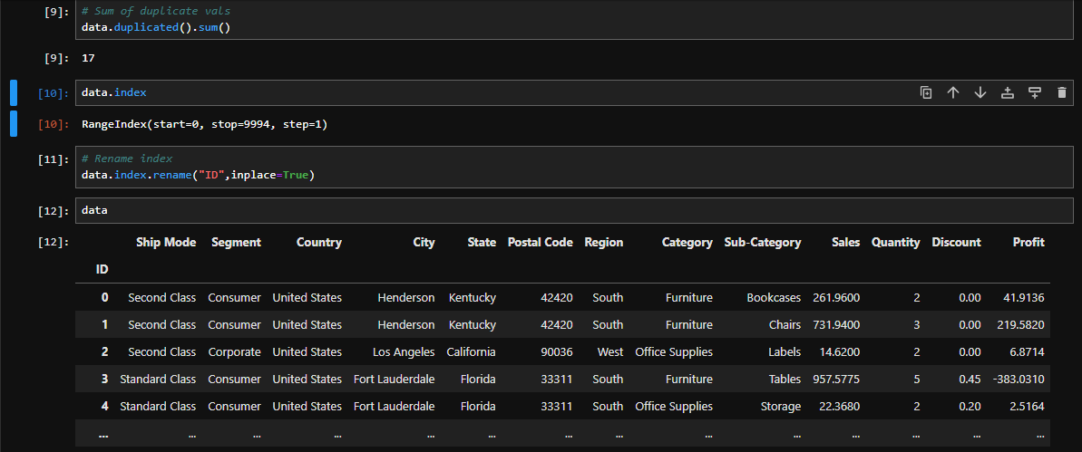
DATA CLEANING
Check for Duplicates and inconsistencies in the data

Slide 5
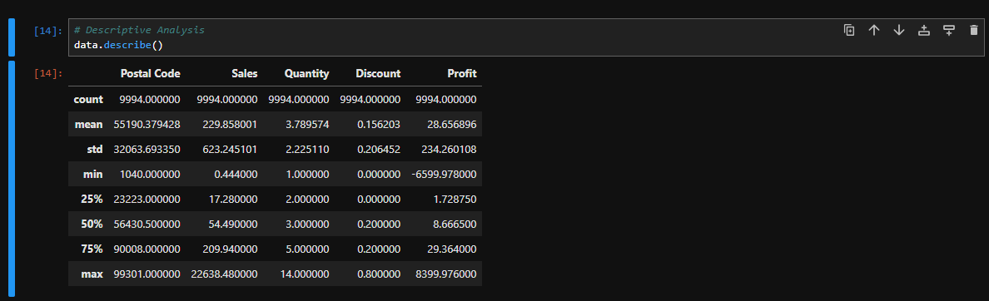
DESCRIPTIVE STATISTICS
Basic Descriptive statistics of the data

Slide 6
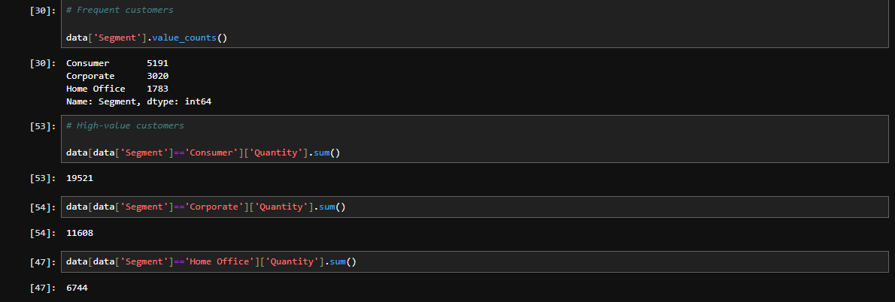
CUSTOMER SEGMENTATION
Customer segmentation based on their purchasing behavior

Slide 7
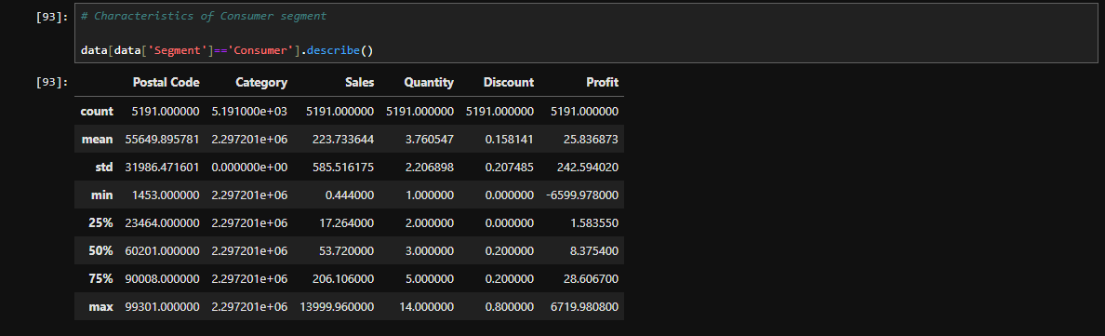
DESCRIPTION OF EACH CUSTOMER SEGMENT
Consumer Segment

Slide 8
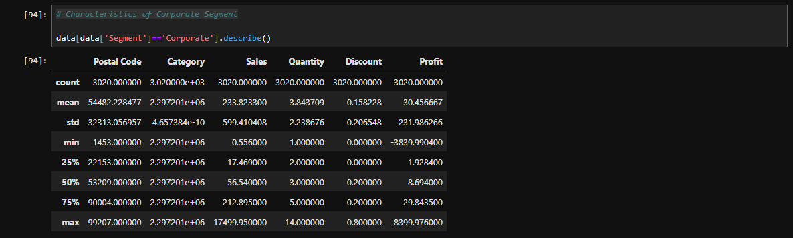
Corporate Segment

Slide 9
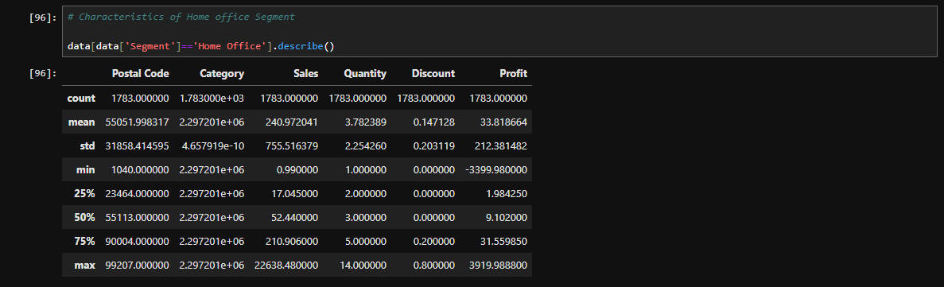
Home Office Segment

Slide 10
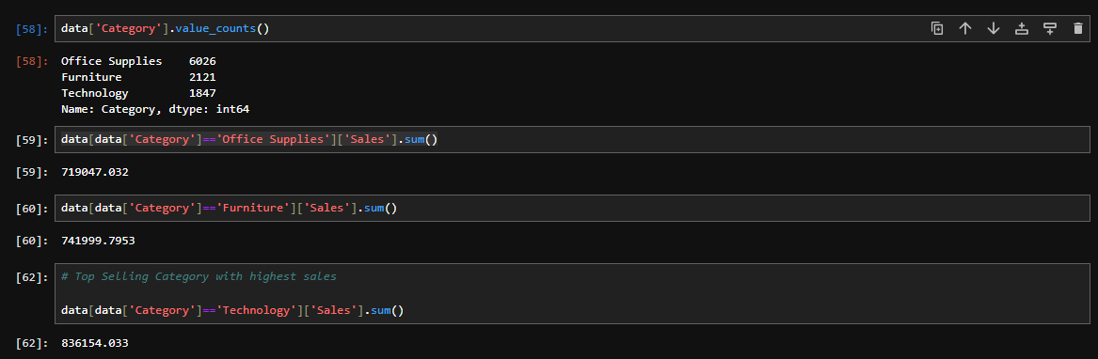
CATAGORY ANALYSIS
Top Selling Category

Slide 11
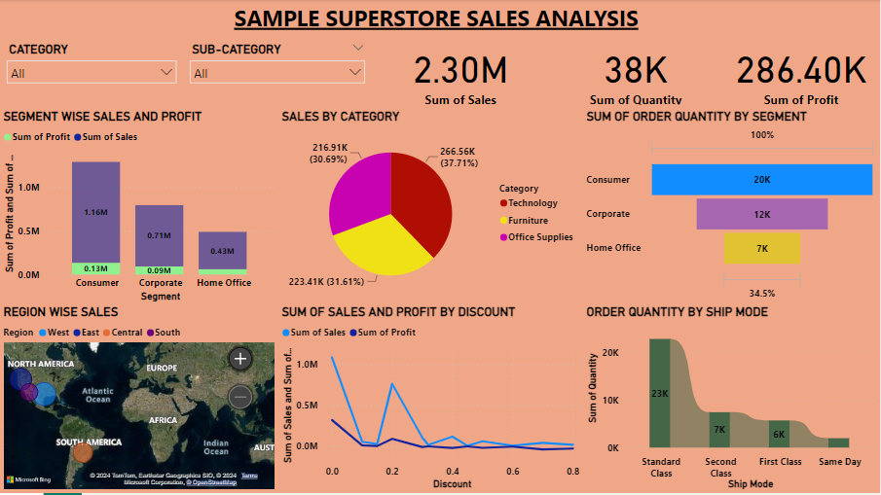
VISUALIZATION – INTERACTIVE DASHBOARD

Slide 12
INSIGHTS DERIVED FROM THE ANALYSIS
Here, we have the sample dataset of Superstore sales in the country called ‘United States’.
As we observed, the maximum sales takes place in the ‘West’ region of the country.
In the given dataset, we have three segments of customers – Consumer, Corporate and Home office.
As per our analysis, we can say that customers of Consumer segment are high-valued and more frequent.
Also more Profit can be expected by Consumer segment.
There are three categories of Products are there in the Superstore such as, Office supplies, Furniture and Technology.
Among these categories, the sales of Technology products is on the Top.
So, we can conclude with the suggestion that they need to reach out more regions and more customers via their existing customers.

Slide 13
TOOLS AND LIBRARIES USED
Tools
Jupyter Notebook – To perform Data loading, Data cleaning, Descriptive Analysis, Statistical analysis.
Power BI – In order to visualize the data and also to create an Interactive Dashboard using various charts and graphs.
Libraries
Numpy – Used to perform mathematical operations (Statistical analysis)
Pandas – Used to perform Data loading, data cleaning, data manipulation and exploration.

